Slide 1
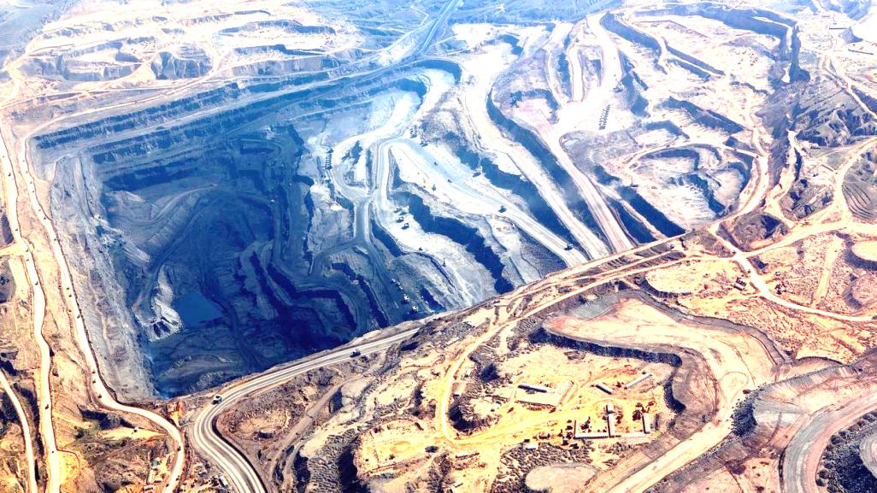
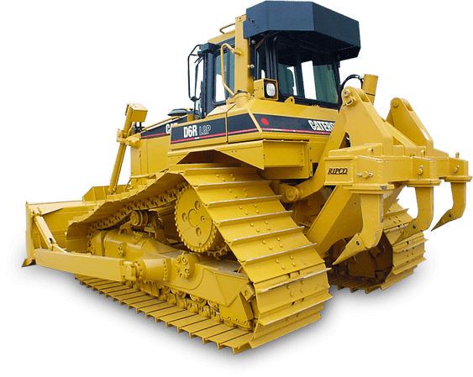
Supply Chain Analytics – Capstone Project
By Aadith Kamalaksha Sreeja

Slide 2
What is Open Pit Mining?
Open-pit mining is a surface mining technique of extracting rocks or minerals from open-pit in the ground also known as a quarry.
Open-pit mines are used when deposits are found near the surface and surface material covering valuable deposits is thin or the material of interest is structurally unsuitable for tunnelling (as would be the case for sand, cinder, and gravel).
Materials that can be extracted by this technique include bitumen, clay, coal, copper, coquina, diamonds, gravel and stone (stone refers to bedrock, whereas gravel is unconsolidated material), granite, gritstone, gypsum, limestone, marble, metal ores, such as copper, iron, gold, silver, and molybdenum, uranium and phosphate.

Slide 3

Datasets and Treatment of Data:
We have 3 sets of data to perform Analysis on:
Cycle Data
Location data
Delay Data
Procedure Followed – Loaded the tables in MySQL Workbench and imputed the null values of the columns taking either the Median or the Average of the column, created stored procedures and loaded the data in Tableau and created the dashboards to get insights.

Slide 4
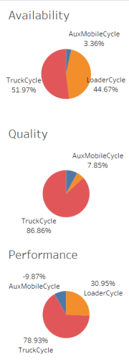
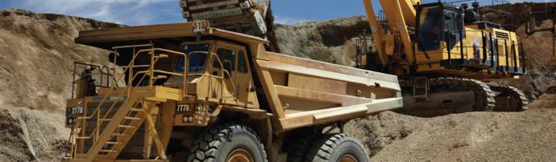
Overall Equipment Effectiveness
When we look at the pie charts here, it’s evident that Trucks are the most efficient of all the Mining Equipment.
Trucks have less down time and are available for operations for more time when compared to other equipment.
Trucks have a higher quality quotient
Trucks also promisingly deliver high performance

Slide 5
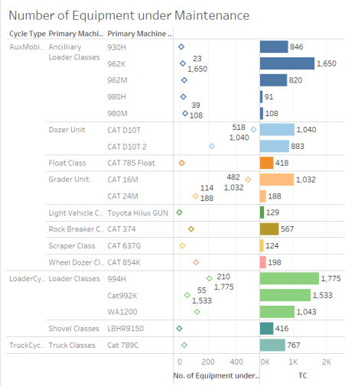
Equipment Availability
Equipment under maintenance is a very important factor in our business. We have to make sure that our equipment is always on the ground.
From this graph here it is evident that Trucks and Loaders spent the least time away from the ground whereas dozer units require heavy maintenance.

Slide 6
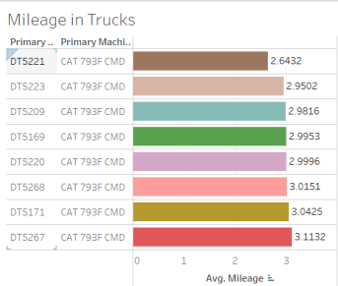
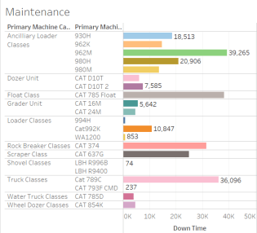
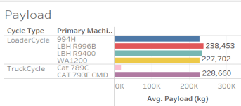
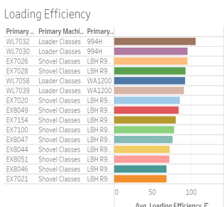
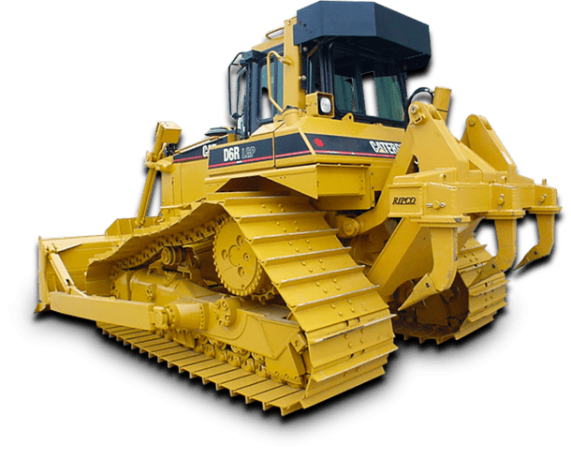
Performance
Insights:
DT5221 has the best mileage
994H and LBH R996B, LBH R9400 has the least maintenance
Loader WL7032 and Shovel EX 7026 have the highest loading efficiency in their respective classes
Loaders have capability of high payload, and in trucks CAT 793F CMD has the ability to take more ores.

Slide 7
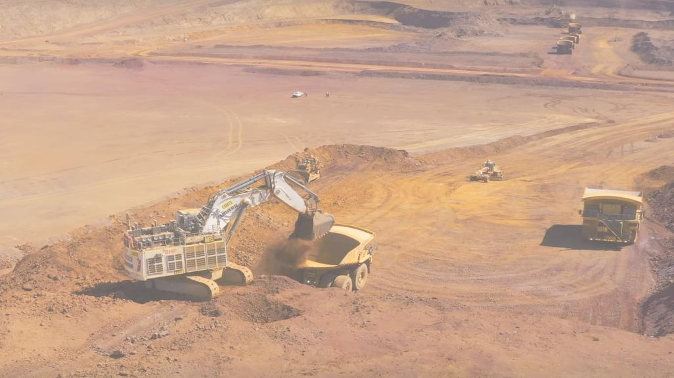
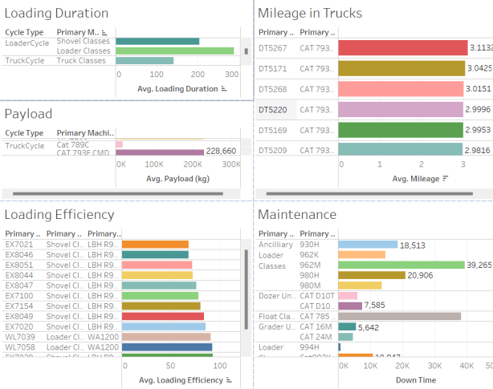
Key Metrics – Low Performance
Insights:
Loader Classes take a longer duration to complete tasks
CAT 789C have the ability to take less payload only.
DT5267 has a lesser mileage when compared to other equipment of the same class
Equipment of Loader and Float categories have high maintenance
Efficiency of shovel classes is less compared to the other classes of equipment especially LBH R9400

Slide 8
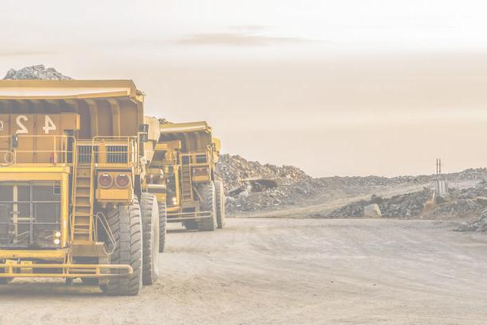
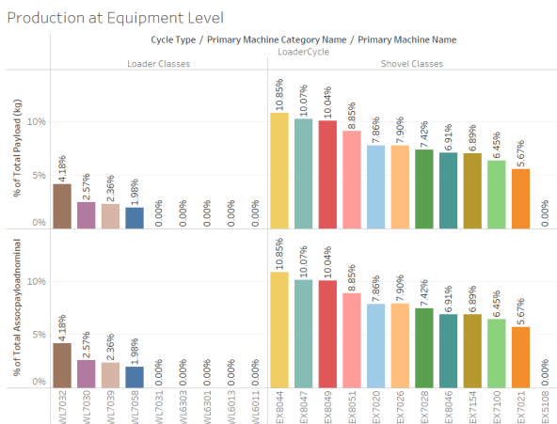
Productivity
Insights:
Shovel Classes transfer the maximum amount of ores.
EX8044, EX8047 and EX8049 are highly effective in transferring payload and are trending at above 10%.

Slide 9
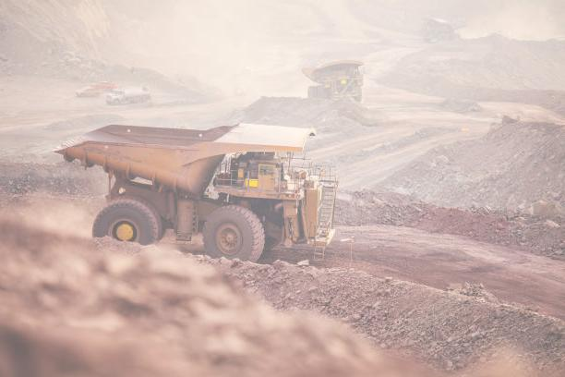
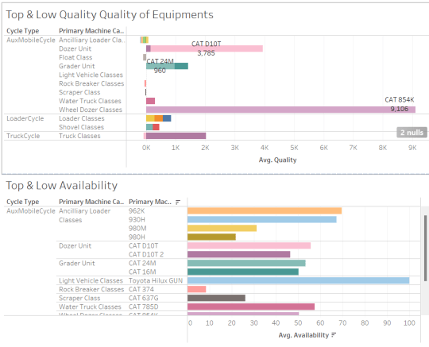
Quality Vs Availability
This graph shows us exactly the difference between a very high productive equipment and a low productive equipment in each class and category which will help us decide which equipment to upgrade and the ones to keep.

Slide 10
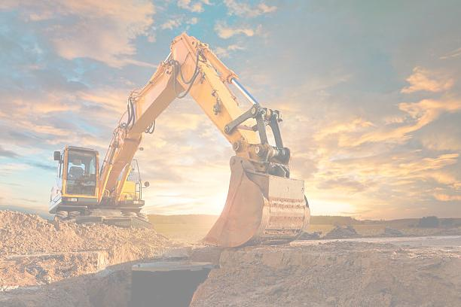
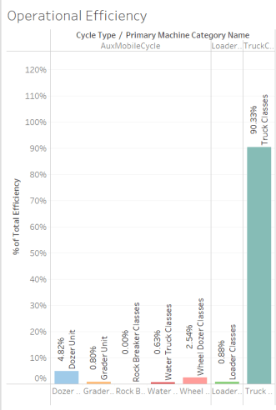
Operational Efficiency
Operational efficiency is key to the success of any business.
Insights:
Rock breaker classes are the least efficient of the lot.
Truck classes are the most efficient equipment

Slide 11
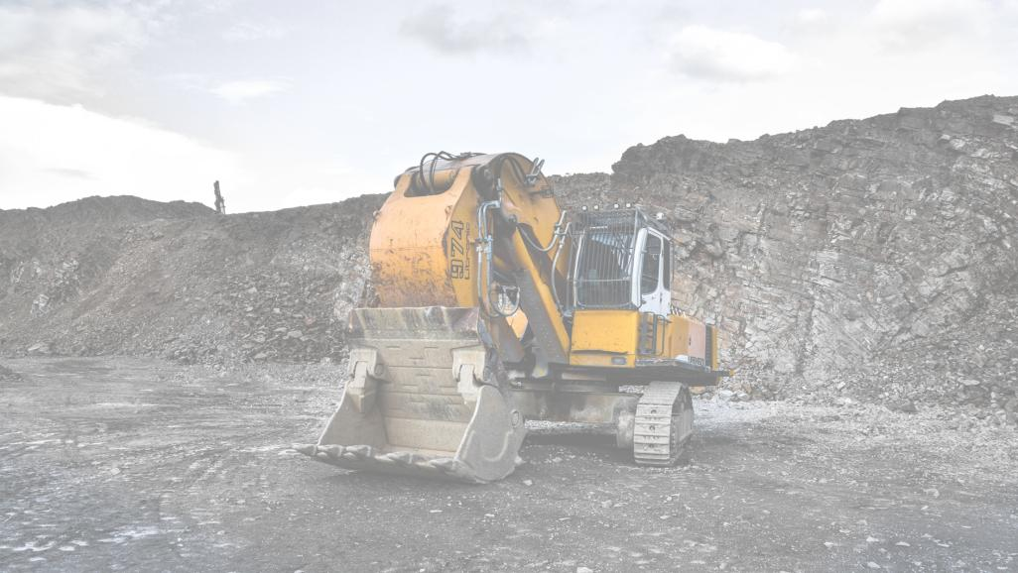
Suggestions
Equipment that are less productive should be replaced by the more productive ones from the same class
Trucks with a higher payload and mileage should be preferred considering the fuel costs
Lesser quality equipment have a higher downtime and should be replaced
There should be on field maintenance to reduce the maintenance time
We should increase the number of Loaders to reduce the loading and waiting time.

Slide 12
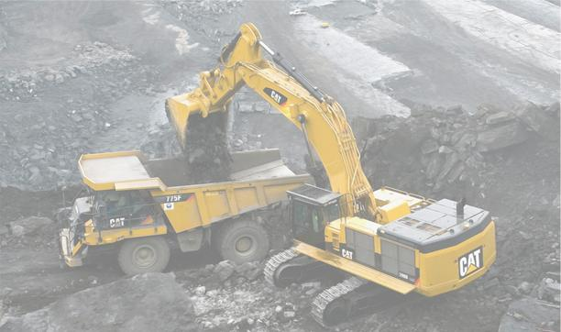
Thank You!

